Slide 1
Appraisals, Builder Docs, and Case Number Transfers

Slide 2
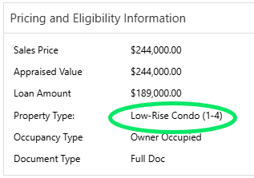
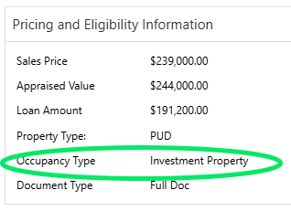
Details That Determine the Appraisal Form
Conv AZ loan in Pinal/ Maricopa County – 3.6
Property type: Low- Rise Condo/ Condo – 1073
Occupancy Type: Investment Property – 1004 & 1007 Combined

Slide 3
Documents Needed to Order the Appraisal
Signed Intent to Proceed
Fully executed contract with the sales price that matches the sales number in the loan details (AZ contracts may be missing the Seller’s signature – okay to order)
Signed Builder Cert (only for FHA and USDA files)

Slide 4
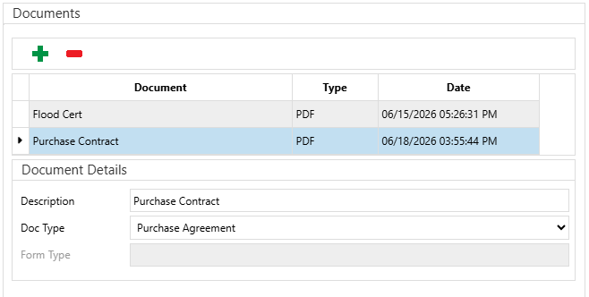
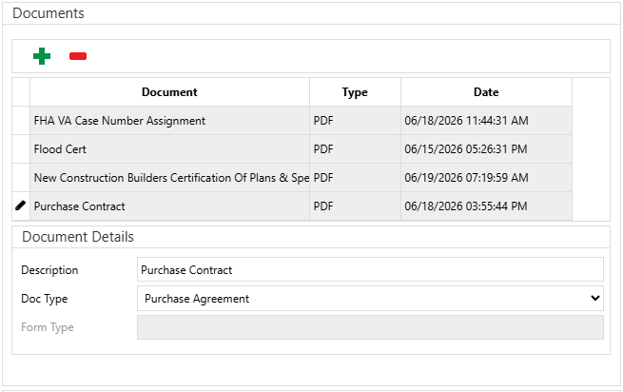
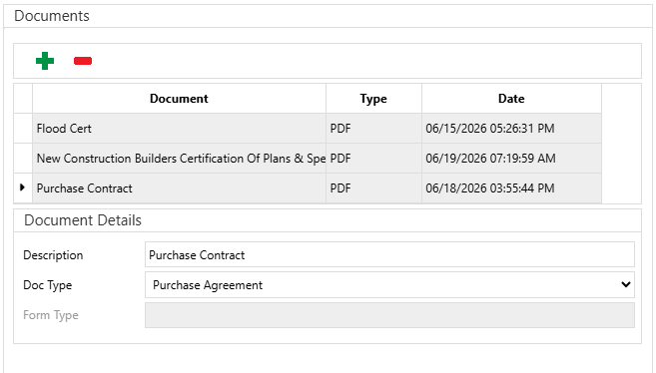
Documents to Attach to the Orders
Conv
FHA
USDA

Slide 5
Adding Comments to the Order (Non-VA Files)
Once the order is acknowledged, select the event drop down 220-Comment
Add the following details in your comments:
  LO and Processor
  max fee and seller credit
  due date and closing date
  type of appraisal needed
Be sure to verify and submit again!
Please stay on the Exchange appraisal screen until the status says “Comment Acknowledged”

Slide 6
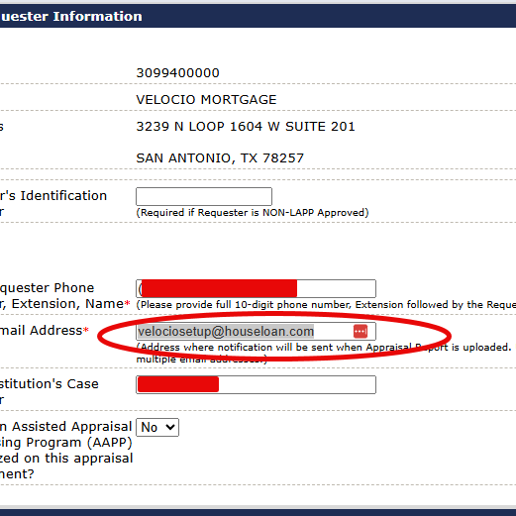
Notes for VA Appraisals
VA appraisals do not require Builder Docs
Please use the email VelocioSetUp@HouseLoan.com for the requestor email (box 1C).
These orders will be placed in Empower as Foreign Appraisal – they do not go to the MetriQ team.

Slide 7
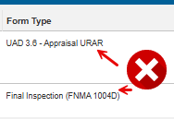
Notes for New 3.6 Orders
Please add C-Stone investor to your comments.
If you have a 3.6 Appraisal, you will need to order a Completion Report 3.6 for the final inspection.
Do not mix formats!

Slide 8
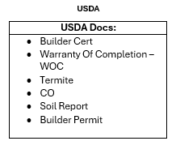
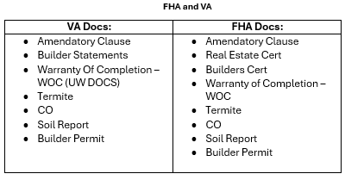
Ordering Builder Docs for SC/NC Files
The file must have signed disclosures and the contract to order builder docs
For Ashton Woods, the case number is required, but it is overall preferred for the case number to be assigned before builder docs are ordered

Slide 9
Transferring FHA Case Numbers Out
Send an email request to FHA&VACaseTransfers&Cancellations@houseloan.com.
Provide the new mortgage company’s Originator ID.
If an appraisal has been ordered and received, the new mortgage company must pay for the appraisal before the appraisal and FHA case number can be transferred.

Slide 10
Transferring FHA Case Numbers In
Velocio will send a transfer request email to the lender that currently holds the case number with our Originator ID and Case Query attached.
If the current mortgage company has ordered and received the appraisal, Velocio must send payment for the appraisal before we can receive the appraisal and FHA case number.
  Request an invoice and W-9 from the current mortgage company for the appraisal.
  Complete the Check Request form.
  Submit the Check Request to Management for approval/sign-off.
  Send the following documentation to BAACCTG-CheckRequests@houseloan.com
    Current mortgage company’s W-9
    Appraisal invoice
    Check Request
Inform the mortgage company that currently holds the case number that payment is being sent, and request the appraisal documents.

Slide 11
Thank you!

