Slide 1

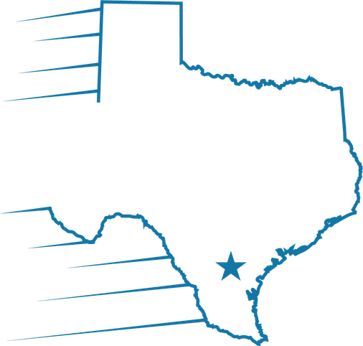

Document Repository Refresh
Portal documents, stacking, and shipping
Training for Processors & Underwriters
Velocio Mortgage | October 2026

Slide 2
Why this matters
Investors now receive every version of each document type.
Proper naming of documents is still a top priority! Because the investor will now see all version, ensure only applicable documents are provided.
Correct document type
Organized one time
No merging required
Every document goes to the document type Underwriting expects — not a catch-all doc type.
Borrower documents arrive as Portal Documents. Rename and organize them once.
Merging is no longer required on most documents.

Slide 3
What's changing in Empower DocRepo
1
Say hello to Portal Documents
Borrower documents simply come in as the new Portal Documents doc type. Rename and organize one time, saving you time.
2
Say goodbye to the auto-index
The auto-index is retired — no more auto-indexed doc types to clean up after upload.
3
Say goodbye to automatic reindex
Automatic reindex is gone as well, so documents stay where you put them.
4
An enhanced shipping policy
No more merging or finals required for most of the documents in the pipeline. Upcoming training calls will identify which documents will still need to be merged or finalized.

Slide 4
New stacking orders and department tags
Stacking orders have been improved and DocRepo now carries tags built for individual departments.
1
2
3
4
Processing
Disclosures
Tax Returns
To be Finalized
Stacking orders now include a Processing order built around how the file is worked.
The Disclosures stacking order has been updated.
A brand new stacking order dedicated to tax returns.
Documents to be Finalized shows what still needs a final version.
Tags: Many tags have been added in DocRepo for different departments to help you review the file — especially beneficial for Processing and Underwriting. Stay tuned for more on how to use them.

Slide 5
Where documents come from
Documents reach the Document Repository through several sources — all of them land in your queue.
1
2
3
Borrower Digital
Loan Officer Digital
Empower Repository
Borrowers upload after applying or creating a BD account — now Portal Documents.
The loan officer uploads directly from their own workspace.
Team members upload straight into the Document Repository.
Reminder: No matter how a document reaches the repository, the Processor reviews every document for accuracy and correct naming before submitting to the underwriter. Skipping this step costs time and creates unnecessary loan conditions.

Slide 6
Your responsibilities as the Processor
1
Upload to the correct document type
Use the document types available in the Underwriting filter so Underwriting can confirm the document ships in the investor package.
2
Merge only where it is still required
Under the enhanced shipping policy, most documents in the pipeline no longer require merging or finals. Merge only when the policy still calls for it.
3
Rename and organize one time
Portal documents come in unnamed. Rename and organize them once, into the doc type Underwriting expects.

Slide 7
Documents that must be separated
Some of these document types may also be used more than once. The next slide explains when.
Bank Statements
FHA Initial 92900
Loan Application – Initial
Paystubs
Permanent Resident ID
Verification of Employment
SSA Validation
Verbal Verification of Employment
Previous Verification of Employment
W-2
Reminder: After choosing the proper doc type, remember to choose the proper location.

Slide 8
One named doc type per borrower, employer, property or account
The doc types just listed can be used more than once — one for each borrower, account, employer, or retained property. Give every doc type a name that identifies it.
EXAMPLE — A borrower with three bank accounts on three different statements
DOC TYPE 1
DOC TYPE 2
DOC TYPE 3
Bank Statements – Bank of America
Bank Statements – Chase
Bank Statements – Wells Fargo
One account or institution per doc type — identify it by account or institution name.
Merge new statements for an account into that account's own doc type, not another one.
The same rule applies to multiple borrowers and multiple properties.

Slide 9
Two doc type reminders
Earnest money deposits — don't duplicate
A bank statement used to identify a cleared earnest money deposit belongs in the Bank Statements doc type. It does not need to be duplicated in the Earnest Money Deposit doc type.
Doc type missing? Add the account or employer in Empower first
If the employer or bank account is not listed in Empower before documents are uploaded, the matching doc type will not be available in the Document Repository.
1
Add the account or employer in Empower, then save.
2
Refresh the Document Repository.
3
Upload and name the associated document in its new doc type.

Slide 10
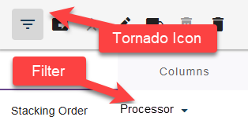
Use the Processor filter to pick document types
HOW TO GET THERE
1
Open the Filters and Columns (tornado) icon.
2
Select the Processor filter.
3
Choose the document type that matches the document.
Why it matters: these document types are the approved list, so Underwriting can confirm the document reaches the investor package.
4
Name the doc type if it supports multiples.
Full list: Document Repository Doc Types reference.

Slide 11
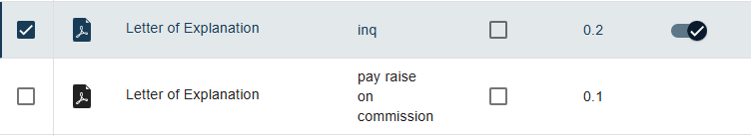
Uploading multiple versions of document
Every document is now uploaded on its own — never merged — so the alternative name is what tells everyone what it covers.
Best practice: Use the alternative name box to say what the letter is for — for example “inq” or “pay raise on commission.”
Name it clearly
A clear alternative name lets the underwriter match the letter to its condition.

Slide 12
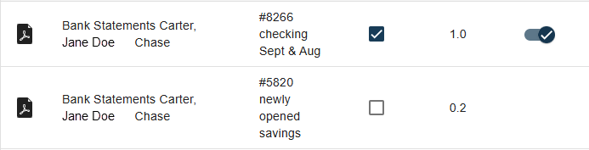
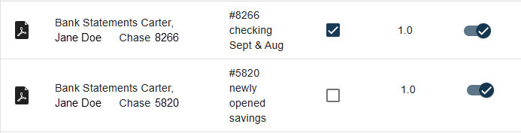
Bank statements: one doc type per account
Each bank account gets its own Bank Statements doc type — not extra versions stacked under a single one.
Wrong: Two accounts, one doc type
Right: One doc type for each account
Only one Bank Statements doc type was created.
Two different accounts were loaded as separate versions of that one doc type.
Underwriting reviews only the most recent version — the other account is never seen.
A separate Bank Statements doc type for each account.
Each is named with the account or institution (e.g. Chase 8266, Chase 5820).
Both accounts reach the underwriter and the investor package.
Remember: A different account always means a new doc type, use the location drop down.

Slide 13
What Underwriting does — and doesn't do
PART TWO
Knowing the underwriter's rules explains why merging correctly is on you.

Slide 14
What underwriters do during initial review
UNDERWRITERS WILL
Review every version
Underwriter will now review every version of a document.
Condition for anything missing
If required information is absent from the upload, a condition is issued.
Mark FINAL only where required
Final Version is no longer required for most documents. Where it still applies, the underwriter selects it.
UNDERWRITERS WILL NOT
Fix correct document uploads
They will not rename, reclassify, or otherwise modify documents on your behalf.
Correct a bad upload themselves
If a document was uploaded incorrectly, they issue a condition naming the deficiency.
Most pipeline documents now ship without a FINAL version being checked.

Slide 15
Common upload issues to avoid
These two problems account for most re-work on conditions.
ISSUE 1 · NOT ORGANIZED OR MERGED WHEN REQUIRED
ISSUE 2 · LINKED TO THE WRONG TYPE
A document is linked to a condition but was never renamed into its doc type, or not merged where merging is still required.
A document is linked to a condition but has been uploaded to the wrong document type.
THE FIX
THE FIX
Rename and organize the portal document into the correct doc type, and merge only if the shipping policy still requires it.
Move it to the correct Underwriting document type before linking it to the condition.

Slide 16
Before You Merge
Merging is now required on only a few documents — when it is, these three checks decide whether it will work.
1
PDFs only
2
Select 2+ files
Only PDF files can be merged. Never upload Word documents or photos.
The Merge icon only opens once two or more documents are selected.
3
Include the FINAL version
Merge new pages into the FINAL version so nothing already reviewed is lost.

Slide 17
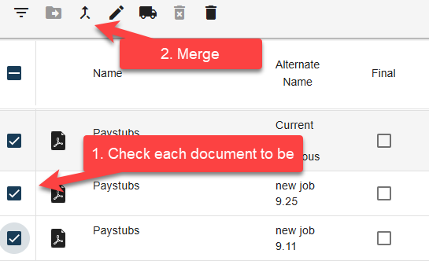
Starting a merge
Select every document that belongs together, then open the Merge icon on the top toolbar.
1
Check each document to be merged
Tick the box beside every version of the doc type that belongs in one file.
2
Click the Merge icon
The Merge icon on the top toolbar only opens once two or more documents are selected.
Remember: only PDFs can be merged.

Slide 18
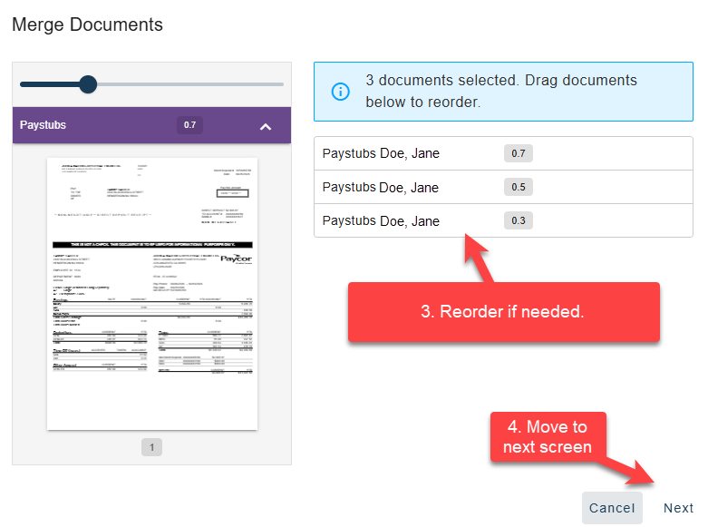
Select the documents and set the order
The first Merge Documents screen lists everything you selected and lets you set the page order.
3
Reorder if needed
Drag the documents in the list until the pages are in the order you want.
4
Move to next screen
Click Next to confirm where the merged file will be saved.
Order matters: put the pages in the sequence the underwriter should read them — the merged file is what the investor receives.

Slide 19
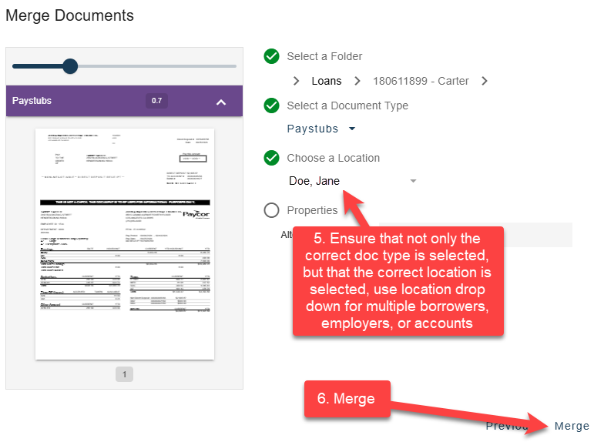
Completing the merge
On the next screen, confirm the document type and location, then complete the merge.
5
Choose a Location
Use the location drop down to land the file under the right borrower, employer, or account.
6
Merge
Confirm the selections, then click Merge.
Watch the location: the correct doc type is not enough — the wrong location puts the merged file under the wrong borrower or account.

Slide 20
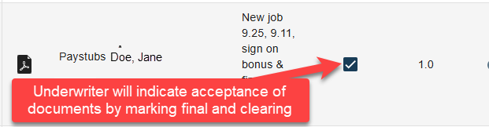
Merge rules and what happens next
A few rules decide when and how a merge works — and what the underwriter does once it does.
RULES FOR MERGING
AFTER YOU MERGE
• Only PDFs can be merged — best practice is to upload PDFs, never Word files or photos.
• Two or more documents must be selected before the Merge icon opens.
• Most pipeline documents no longer require merging or finals at all.
• Where a FINAL is still required, the underwriter marks the document FINAL and clears the condition.
• New pages added later merge into that FINAL version — nothing earlier is lost.
Reminder: Once the underwriter has completed the initial loan review, do not delete anything from the Document Repository — the underwriter handles deletions.

Slide 21
Other tools worth knowing
All Versions toggle
Properties
Turn it on to see every version of a document. Known issue: versions can appear at the end of the list — search or filter to a single document type instead.
Shows all information about a document. Final Version appears at the bottom of the list when available.
Conditions
Mark as Delete
Select a document, then the footprints icon to link it to a condition. Use the tornado filter to view outstanding conditions only.
A soft delete. The document is hidden from the default view and is NOT shipped to the investor. Only admins or compliance can hard-delete.
Reminder: Once the underwriter has completed the initial loan review, processors must not delete anything from the Document Repository. If something needs to be deleted, the underwriter will handle it.

Slide 22
Five things to remember
1
Borrower documents arrive as Portal Documents — rename and organize them one time.
2
Merge only where the enhanced shipping policy still requires it.
3
Give each borrower, account, or property its own named doc type.
4
Use the new stacking orders and department tags to review the file.
5
After initial UW review, never delete from the repository — the underwriter handles deletions.
Questions on a specific document type? Check the Document Repository Doc Types reference or ask your Underwriting partner.

