Slide 1
GIFT LETTER REQUIREMENTS
FHA vs. Conventional / USDA / VA
A side-by-side comparison of donor certification, documentation, and evidence-of-transfer requirements
FHA GIFT LETTER
CONV / USDA / VA GIFT LETTER
Prepared for the Velocio Loan Officer Team | Source: FHA Gift Letter and Checklist (7-22-2026) & Gift Letter — Conventional, USDA and VA (Rev. 8-24-26)

Slide 2
AT A GLANCE
Same intent, different paperwork
Every gift letter exists to prove the same thing to underwriting: the money is truly a gift, from a legitimate source, with no repayment expected. But FHA and Conventional/USDA/VA use different forms with different structures — mixing them up creates stips.
1
Different certification structure
2
Business & trust funding — Conv/USDA/VA only
FHA uses two separate certifications (Donor + Recipient). Conventional/USDA/VA uses one combined letter, addressed “To Whom It May Concern.”
Only the Conventional/USDA/VA letter lets a donor certify funds came from a business or trust account — with a 100% ownership rule for USDA/VA.
3
Same core prohibitions
4
Documentation checklists diverge
Both forbid donors with any interest in the transaction (seller, agent, builder, loan officer) and both reject “Cash on Hand” as a source.
FHA splits evidence into “prior to settlement” vs. “at settlement” paths. Conventional and USDA/VA reference the Closing Disclosure (CD) directly.
Velocio Mortgage | Gift Letter Requirements: FHA vs. Conventional / USDA / VA
2

Slide 3
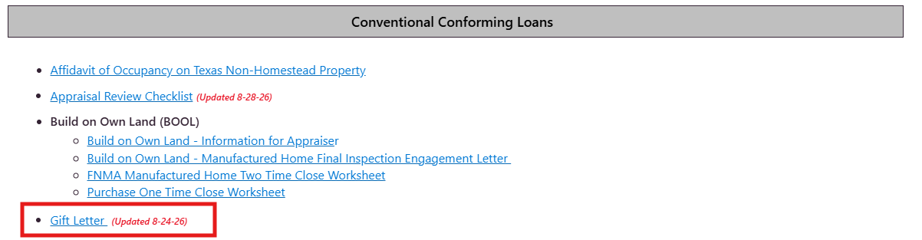
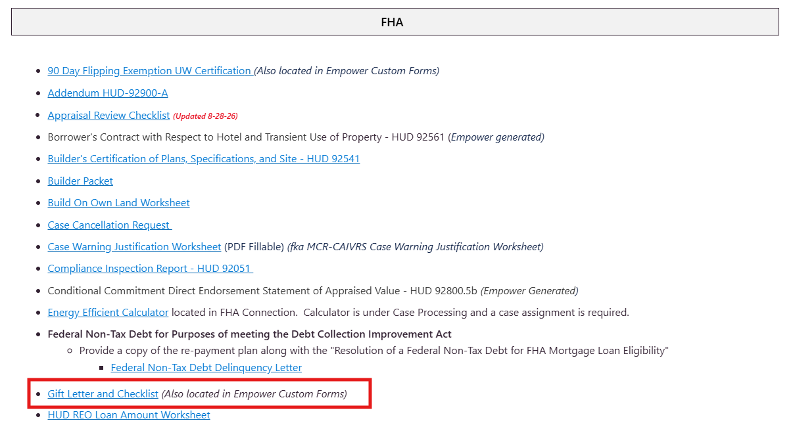
AT A GLANCE
Where do I find the blank gift letter ???
This is found in our share point under Forms and Worksheets: https://houseloan1.sharepoint.com/sites/UW/SitePages/FormsandWorksheets.aspx

Slide 4
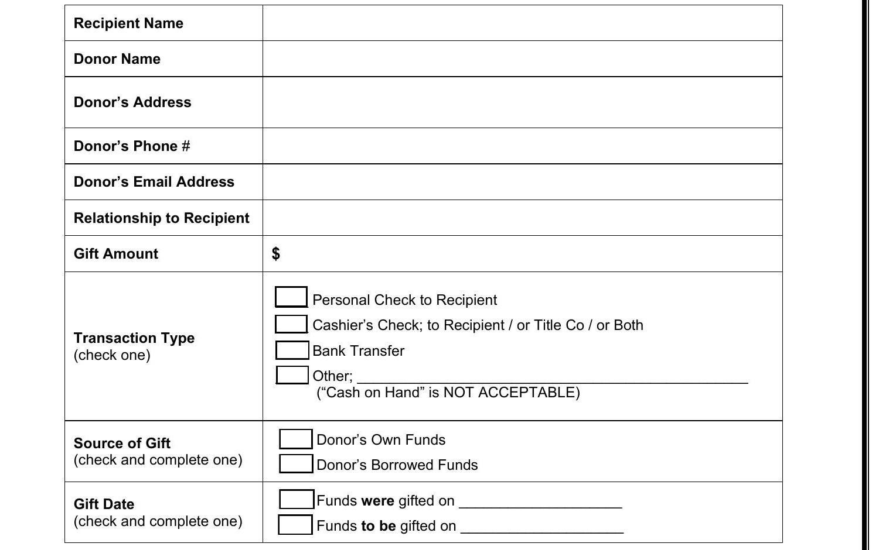
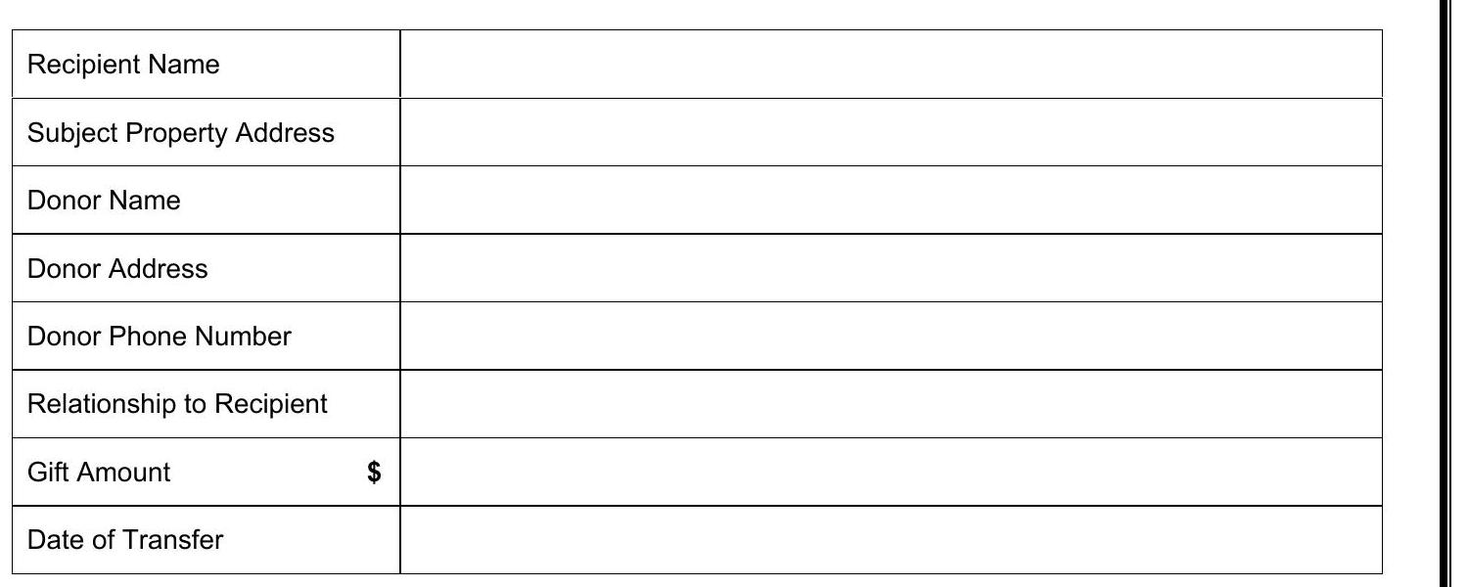
1
COMPARISON 1
Required data fields
FHA
CONV / USDA / VA
Gift Letter — Conventional, USDA and VA — page 1 field table
FHA Gift Letter and Checklist — page 1 field table
KEY DIFFERENCES
• Only Conventional/USDA/VA captures Subject Property Address • Only FHA captures the Donor's Email Address
• FHA totals 7 fields; Conv/USDA/VA totals 8 (adds property address + transfer date)
Velocio Mortgage | Gift Letter Requirements: FHA vs. Conventional / USDA / VA
3

Slide 5
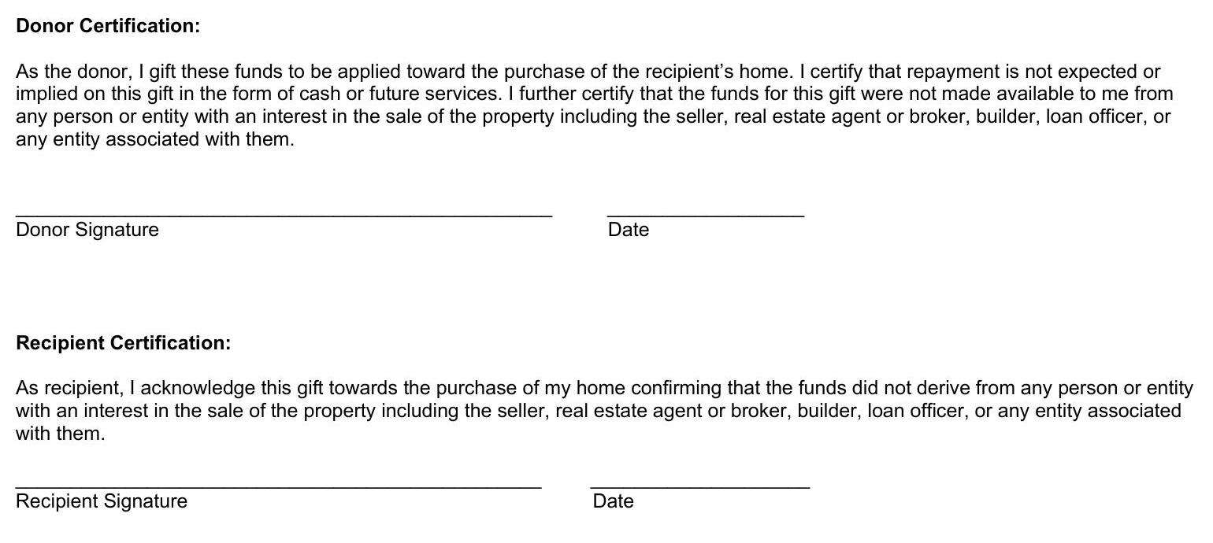
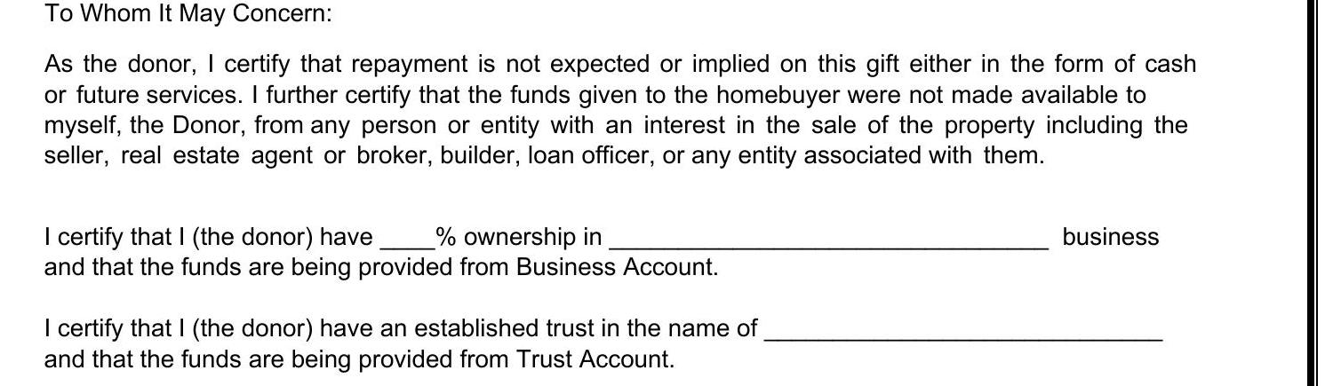

2
COMPARISON 2
Certification & signature structure
FHA
CONV / USDA / VA
Conv/USDA/VA — one combined letter, “To Whom It May Concern”
FHA — separate Donor Certification and Recipient Certification, each individually signed
KEY DIFFERENCE
FHA requires the donor and recipient to certify and sign separately — two distinct statements, each with its own signature and date line. Both certifications repeat the same interested-party prohibition independently.
Signed once by Donor and once by Recipient on the same letter
Velocio Mortgage | Gift Letter Requirements: FHA vs. Conventional / USDA / VA
4

Slide 6
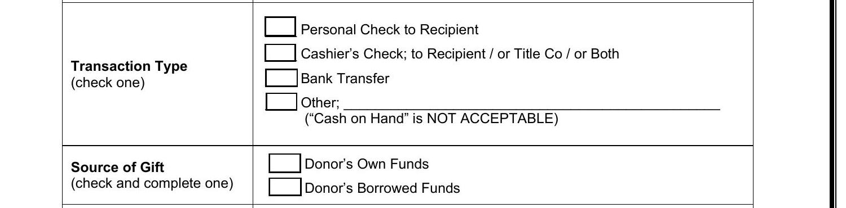
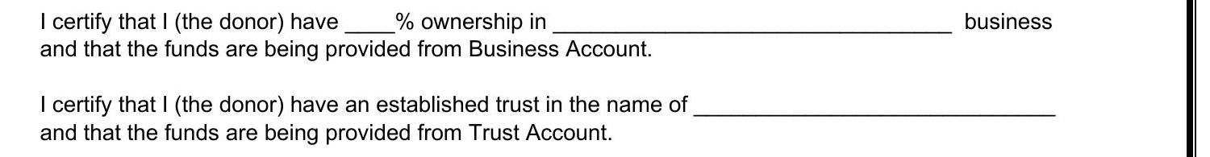

3
COMPARISON 3
Source of funds & ownership rules
FHA
CONV / USDA / VA
Conv/USDA/VA — Business Account / Trust Account certification (not on FHA form)
FHA — explicit Transaction Type & Source of Gift checkboxes
Conv/USDA/VA checklist — interested-party rule + ownership note
⚠ WATCH FOR
Ownership threshold differs by program:
Conventional accepts any percentage of business ownership; USDA and VA require the donor to own 100% of the business before business-account funds qualify as a gift source.
FHA has no business/trust account option at all
Velocio Mortgage | Gift Letter Requirements: FHA vs. Conventional / USDA / VA
5

Slide 7
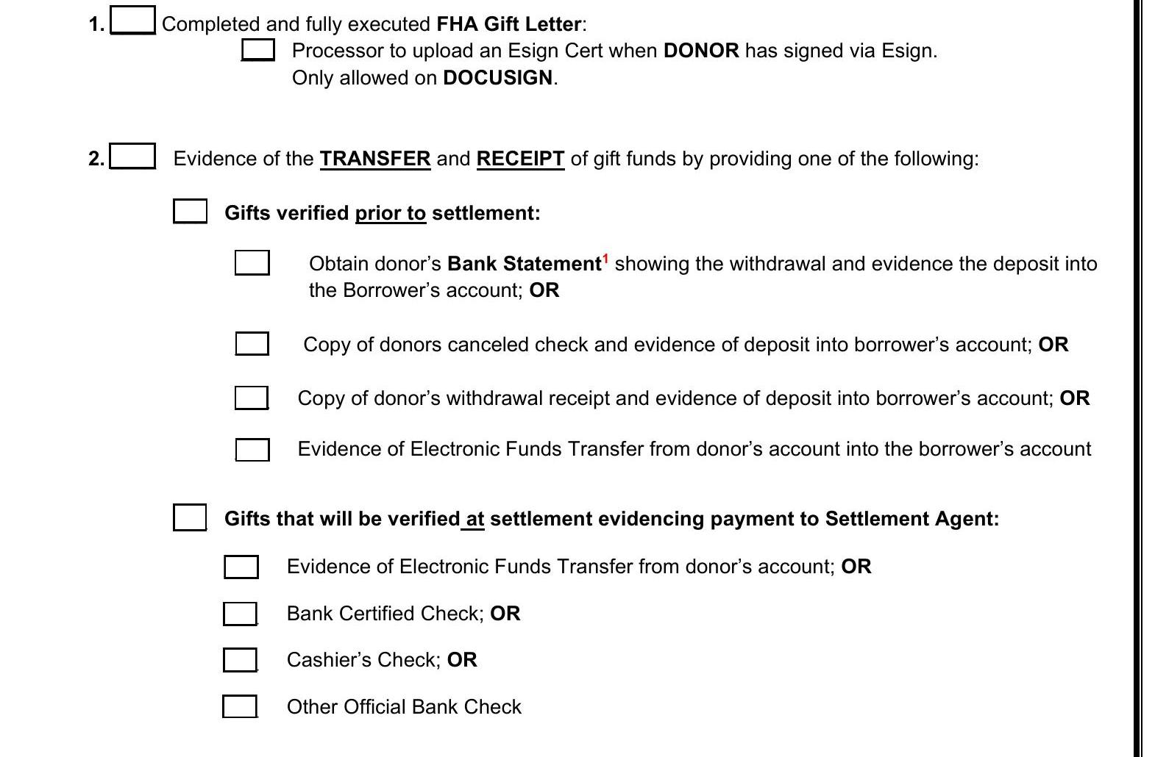
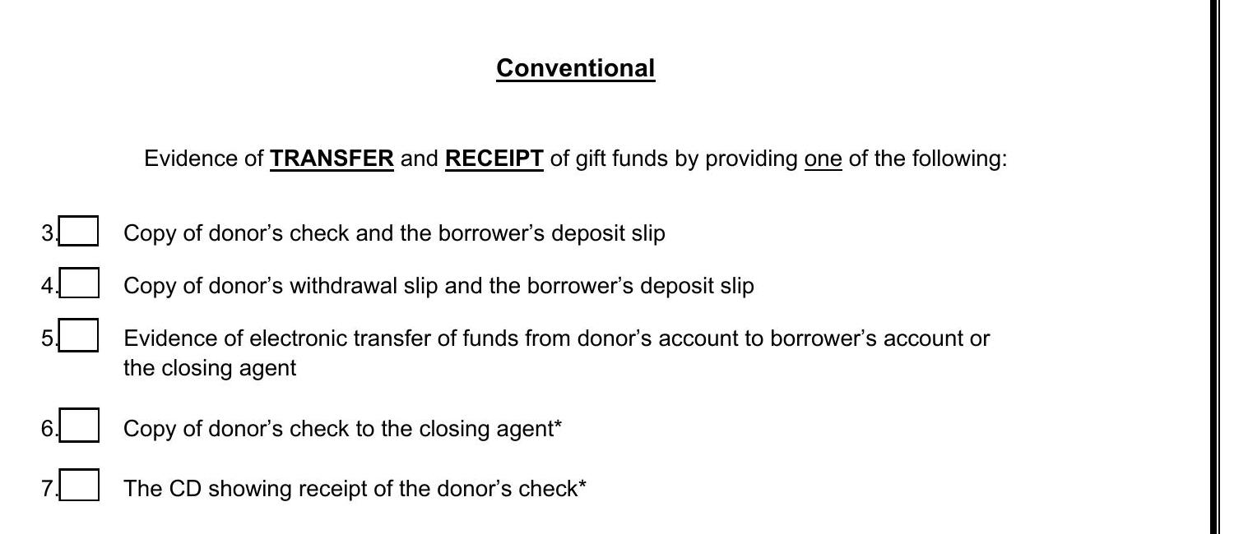
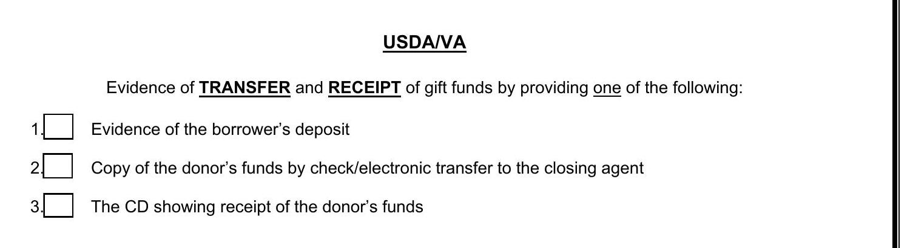
4
COMPARISON 4
Evidence of transfer & receipt checklist
FHA
CONV / USDA / VA
Conventional — 7 evidence options, incl. Closing Disclosure (CD)
FHA — “prior to settlement” vs. “at settlement” evidence paths
Best Option – WIRE Funds Directly to Title
Documenting funds to close is the primary challenge for our customers – once gift letter is executed, ensure funds are wired and confirmed received at title, prior to submission for final loan approval.
USDA/VA — simplified 3-item evidence list, also CD-based
Velocio Mortgage | Gift Letter Requirements: FHA vs. Conventional / USDA / VA
6

