Slide 1
BUILDER CONTRACT REVIEW TRAINING
How to Read a Builder Contract
A working example using the Starlight Homes contract package
Accuracy checks for: Name & ID match • Property details • Pricing & financing • Builder contributions • Signatures
Prepared for the Velocio Sales & Ops Team | Part 1 of a multi-part series

Slide 2
WHY IT MATTERS
One typo can delay closing — or void a benefit
Buyer name & ID match
Property & lot detail accuracy
1
2
A misspelled or mismatched name across the contract, exhibits, title, credit report, HOI and government ID can stall loan approval or title work. Biggest issue is mismatch from how borrower enters name at PreQual -- Double check BEFORE hard credit is pulled
Lot #, plan, elevation, and address must match exactly across every document — inconsistencies raise title and appraisal issues.
3
Builder contribution terms
4
Signatures & dates
Advantage Program dollars and rate buydowns are conditional — missed requirements can void the benefit entirely.
An unsigned or undated exhibit means a term isn't yet binding — including the Contract's own Effective Date.
Velocio Mortgage | Builder Contract Review Training
2

Slide 3
THE PACKAGE
What's inside this contract package
Contract of Sale & Escrow Instructions
SNAPSHOT
Exhibit B — HOA Membership Notice
COMMUNITY / LOT
Magma Ranch – Lot 5, Plan 1177, Elev. R
Exhibit C — Westwood Insurance Opt-Out
ADDRESS
12893 East Wallflower Lane, Florence, AZ
Exhibit E — Advantage Program Addendum
PURCHASE PRICE
$309,990
Exhibit F — Special Stipulations
DEPOSIT
$1,500
Starlight Homes Earnest Money Receipt
FINANCING
USDA Rural Loan via Velocio
Loan Application Prep Sheet
EST. CLOSING
October 20, 2026
Velocio Mortgage | Builder Contract Review Training
3

Slide 4
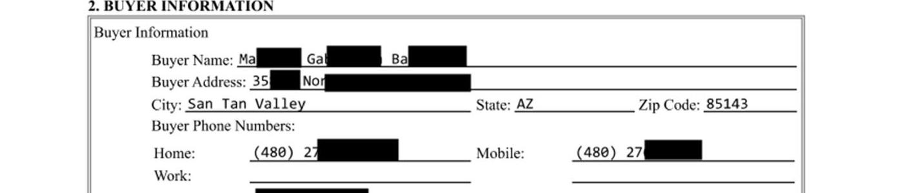
1
STEP 1
Verify the buyer's name — everywhere
The buyer's name appears on at least six separate pages in this package. Before anything else, confirm the spelling is identical on every document and matches the buyer's government-issued ID — don't rely on “it looks right.”
WHAT TO CHECK
Spelling matches exactly across the Contract, all Exhibits (B, C, E, F), the Earnest Money Receipt, and the Loan Application Prep Sheet
Contract — Section 2, Buyer Information
Name order and middle name/initial are consistent — watch for nicknames vs. legal names
Name matches the government-issued ID collected at loan application
Loan Application Prep Sheet — header block
Co-Buyer fields: confirm intentionally blank vs. missing information
Velocio Mortgage | Builder Contract Review Training
4

Slide 5
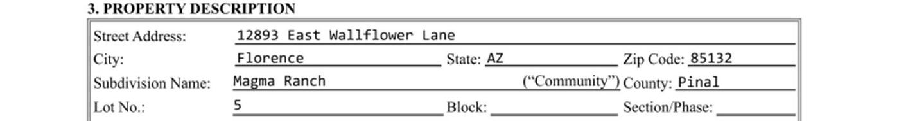
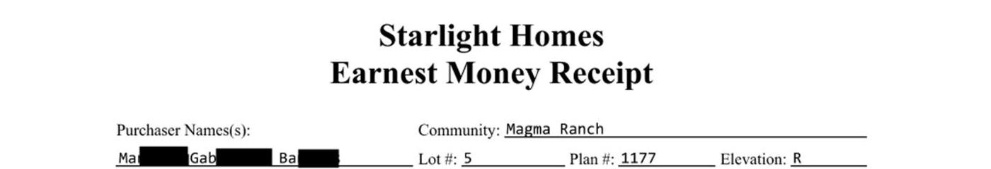
2
STEP 2
Confirm property & community details
Lot number, plan, elevation, address, and county need to match exactly across the Contract and every Exhibit — these details drive title work, HOA enrollment, and appraisal.
CROSS-CHECK
Community
Magma Ranch
Contract — Section 3, Property Description
Lot #
5
Plan #
1177
Elevation
R
Address
12893 E. Wallflower Ln
Earnest Money Receipt — community/lot/plan/elevation
County
Pinal, AZ
Velocio Mortgage | Builder Contract Review Training
5

Slide 6
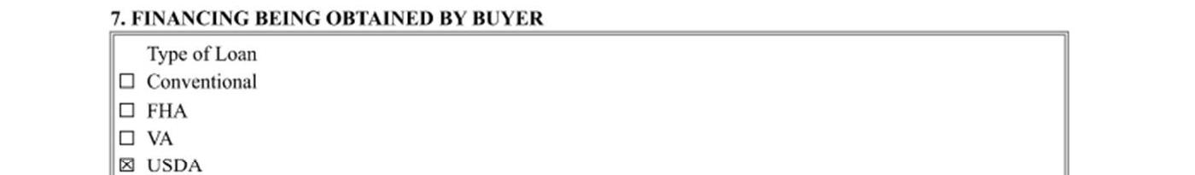
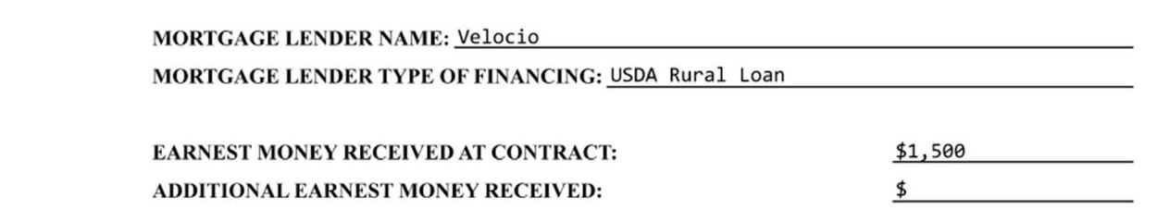
3
STEP 3
Purchase price, deposit & financing type
Confirm the Total Purchase Price and Deposit tie out to the Earnest Money Receipt, and that the financing type shown in Section 7 matches the lender's file.
$309,990
Contract — Section 4, Purchase Price
Total Purchase Price
$1,500
Contract — Section 7, Financing Being Obtained by Buyer
Deposit (Earnest Money)
USDA
Loan Type — confirm matches receipt
Earnest Money Receipt — lender & financing type
Velocio Mortgage | Builder Contract Review Training
6

Slide 7
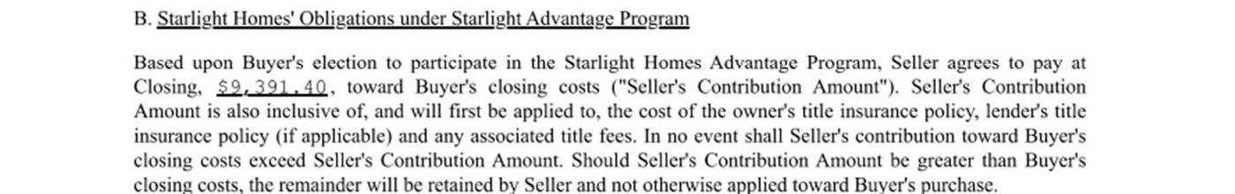
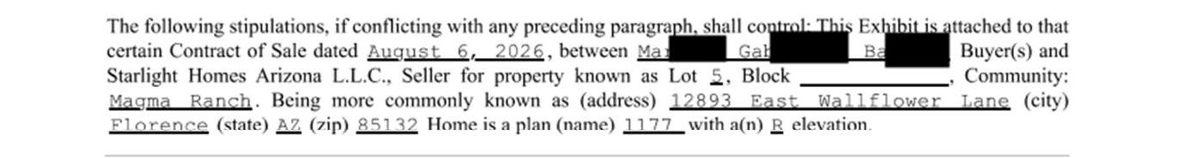
4
STEP 4
Builder contribution terms — Exhibit E
The Advantage Program contribution is conditional, not guaranteed. Read Section B carefully — the dollar amount only applies if every requirement in Section A is met.
$9,391.40
Seller's Contribution Amount — applied first to title insurance & closing cost fees, capped at this amount
Exhibit E, Section B — Starlight Homes' Obligations under Advantage Program
CONDITIONAL ON:
1. Financing
with Velocio Mortgage (Participating Lender)
2. Title
with AW Title of Texas / First American
3. Loan Application
returned within 5 days of contract signing
Exhibit F — rate buydown is tied to the same Advantage Program compliance
Velocio Mortgage | Builder Contract Review Training
7

Slide 8
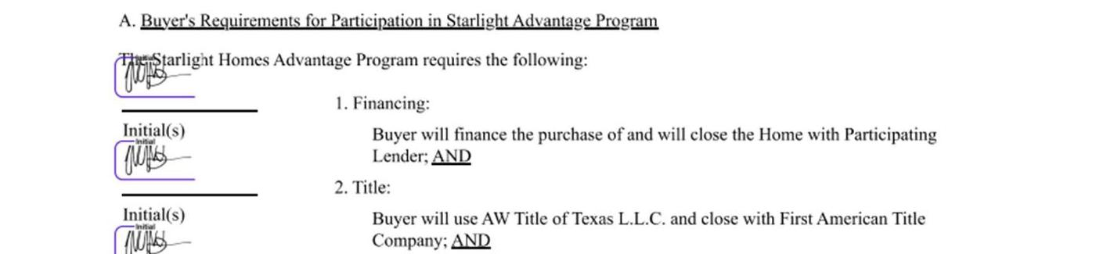
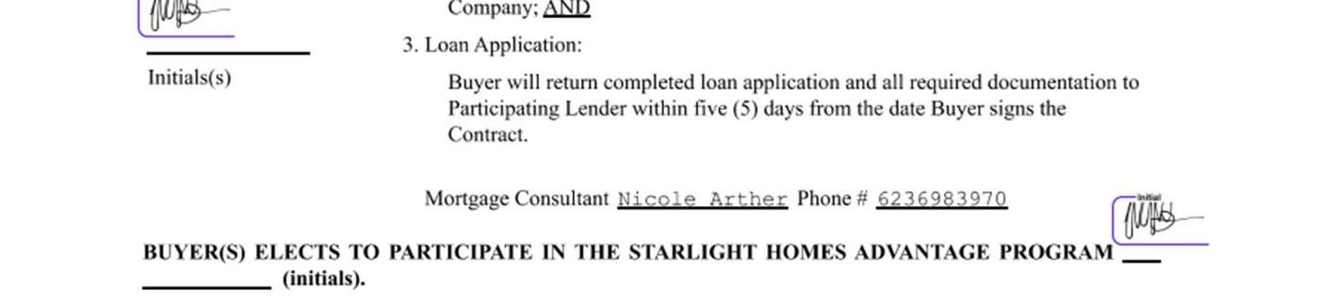
5
STEP 5
Confirm every required initial is present
Exhibit E requires a separate initial for each of the three Advantage Program requirements, plus one to formally elect into the program. A missing initial can be read as non-acceptance of that specific term.
⚠ RED FLAG
Make sure all initials are inplace, for 1. Financing, 2. Title, 3. Loan Application and the borrower has elected to participate in the Advantage Program!!
Exhibit E — Requirements 1 (Financing) and 2 (Title): initialed
Before this file moves forward, confirm with the sales counselor whether any missing initials were an oversight or an intentional carve-out — it directly affects whether the buyer is bound to the 5-day loan application requirement that protects the $9,391.40 contribution.
Exhibit E — Requirement 3 (Loan Application): initial line is blank
Velocio Mortgage | Builder Contract Review Training
8

Slide 9
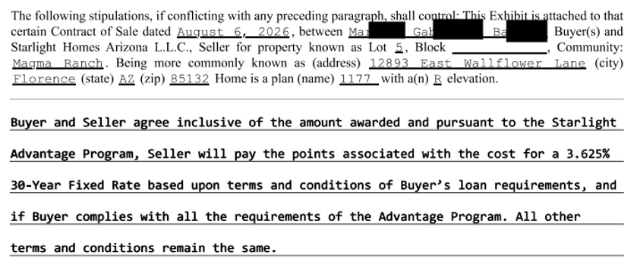
6
STEP 6
Rate buydown stipulation — Exhibit F
Exhibit F ties the Seller's points payment to the same Advantage Program compliance reviewed in Exhibit E — the two exhibits must be read together, not in isolation.
3.625%
Rate Seller is buying down to
30-Yr Fixed
Loan term this rate applies to
WHAT TO VERIFY
• Rate and term shown here match what the loan officer has quoted the buyer
• “All other terms and conditions remain the same” — confirm no earlier exhibit is contradicted
• This benefit voids if Exhibit E's Advantage Program requirements are not fully met
Velocio Mortgage | Builder Contract Review Training
9

Slide 10
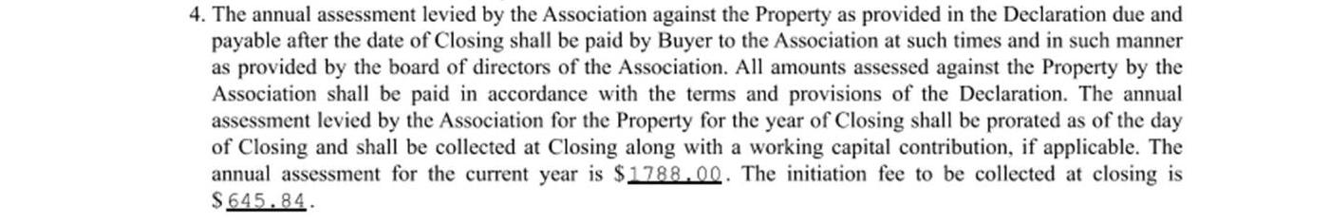
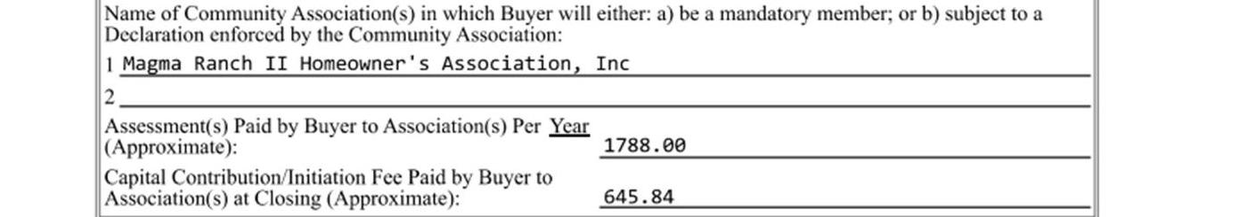
7
STEP 7
Cross-check HOA & closing cost figures
The HOA assessment and initiation fee are stated in two places — Exhibit B and Contract Section 12. Both must show the same numbers.
MATCHING FIGURES
$1,788.00
Annual HOA assessment (current year)
Exhibit B, Item 4 — Homeowner's Association
$645.84
Initiation fee collected at closing
Also confirm: Association name — “Magma Ranch II Homeowner's Association, Inc.” — is spelled identically in both places, and the Pinal County recording reference (Cabinet F, Slide 193) is present in Exhibit B.
Contract Section 12 — Community Association Information
Velocio Mortgage | Builder Contract Review Training
10

Slide 11
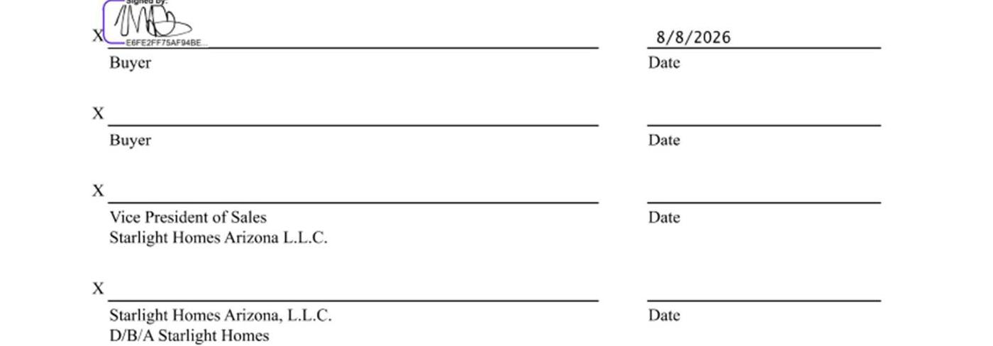
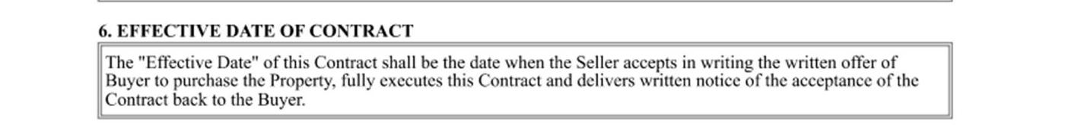
8
STEP 8
Signature & date completeness
An exhibit isn't binding until it's signed by both parties. Check every signature block — a blank Seller line can mean a key term (or the Contract's Effective Date itself) hasn't taken effect yet.
⚠ WHY THIS MATTERS
Per Section 6 of the Contract, the “Effective Date” only begins once the Seller accepts in writing and delivers notice of acceptance back to the Buyer.
In this package, the Buyer has signed and dated Exhibits B, C, F, and the Loan Application Prep Sheet (8/8/2026), but the Seller / VP of Sales signature lines on Exhibits B and F are still blank.
Exhibit F — Buyer has signed (8/8/2026); Seller / VP of Sales lines are blank
Confirm counter-signature is obtained — and file dated — before treating any contingent term (Effective Date, 5-day loan deadline, Advantage Program) as locked in.
Contract — Section 6, Effective Date of Contract
Velocio Mortgage | Builder Contract Review Training
11

Slide 12
RECAP
8-point contract review checklist
Buyer name spelled identically & matches ID
Lot, plan, elevation, address & county consistent
✓
✓
Purchase price & deposit tie to Earnest Money Receipt
Financing type matches lender file (USDA – Velocio)
✓
✓
Builder contribution amount & conditions understood
Every required initial is present on Exhibit E
✓
✓
Rate buydown terms cross-checked against Exhibit E
HOA figures match & signatures/dates are complete
✓
✓
Coming next: supplemental deep-dives on Exhibit A (Contract terms), broker commission rules, and a buyer-facing walkthrough of this same package.

