Slide 1

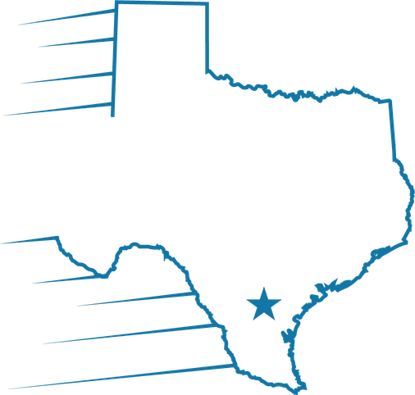
Velocio
Processor expectations
and timeline

Slide 2
Rush files closing in 21 days or less:
Complete the initial review within 1-3 days of assignment, then submit to UW with the needs list sent to the borrower the same day.

Slide 3

Standard files:
Complete the initial review within 3-5 days of assignment, then submit to UW with the needs list sent to the borrower the same day.

Slide 4

Welcome
Welcome contact:
Send
Send the Welcome email and initial needs list the same day the file goes to UW.
Follow up
Follow up with a phone call, and set expectations for documents and timing.

Slide 5

Email standard:
Acknowledge every email within 24 hours — even a simple “received, I’ll follow up if I need anything further” — so borrowers and partners are never left waiting.

Slide 6
Phone standard:
Return every call and voicemail within 24 hours, and log the outcome in the file so the next touch picks up where the conversation left off.

Slide 7

Conditions:
Review every UW decision within 48 hours of disposition, clear what you can in-house, and send the borrower a clear list of what is still outstanding.

Slide 8
Pipeline cadence:
Touch every file closing in the next 30 days 2-3 times a week, document each touch, and escalate early when a milestone is at risk.

