Slide 1

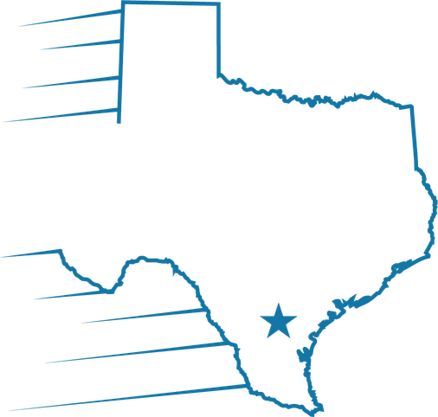

Reconnecting
One team. One Goal. Reconnected
Opening the lines of communication between Processing, Underwriting and Closing

Slide 2
Think of your UW as an old friend
re·con·nect·ing
You miss your UWs ……and they miss you.
To establish a new or better relationship with someone you have lost touch with.
Rebuilding a connection
Renewing communication
Restoring trust
Underwriting is missing their old friends!

Slide 3
What to talk to your UW about
01
Unclear conditions
02
Conditions you can't get
A condition on a file where you're unsure what is actually needed.
You can't obtain it, but you have another idea to offer or need another idea.
03
Conditions that may not apply
04
General file questions
You think it isn't needed, and you can explain and document why.
Anything about a file that has already been underwritten.

Slide 4
Underwriting wants to hear from you
Call, email, or IM your Underwriter with any question. They will gladly share their thought process, what else you could provide, and answer questions on your file.
Call them
Bring alternatives
Flag what's not needed
When a condition isn't clear, pick up the phone.
Can't get a condition? Share the idea you do have that might work instead.
Point out loan standards that may clear a condition.
The first place you should go is the UW — they know more about that file than anyone.

Slide 5
RECONNECT: what it stands for
R
Relationships
Build strong ties between Underwriting and OPS — LOs, processors, closers.
E
Engage
Talk to us. Ask questions — we're here to work with you.
C
Communicate
Open communication prevents misunderstandings and last-minute surprises.
O
One Team
Same goal: getting qualified borrowers to the closing table.
N
No Question Is Too Small
We'd rather answer early than solve a larger issue later.

Slide 6
RECONNECT: what it stands for (cont.)
N
Navigate Together
Guidelines are complicated. Your UW can help you navigate them.
E
Educate
Use questions and scenarios as opportunities for everyone to learn.
C
Collaborate
Instead of 'us vs. them', work through difficult loans together.
T
Trust
Reconnecting is ultimately about rebuilding trust between departments.

Slide 7
One Team. One Goal.
Reconnected. Call, email, or IM your UW today.

