Slide 1


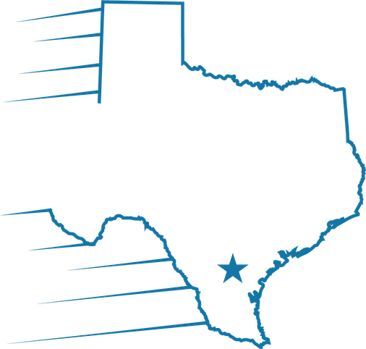
Momentum in Motion
Velocio Mortgage Summit 2026
Presented by: Velocio Mortgage
Date: October 2026

Slide 2

Details Of Transactions
Update once CD is Finalized
Compare you Final Cash to Close on CD to UW condition. If it is more than the UW has conditioned based on LE. Needs to be updated and submitted back to UW to determine if additional assets will be required and remain CTC.

Slide 3
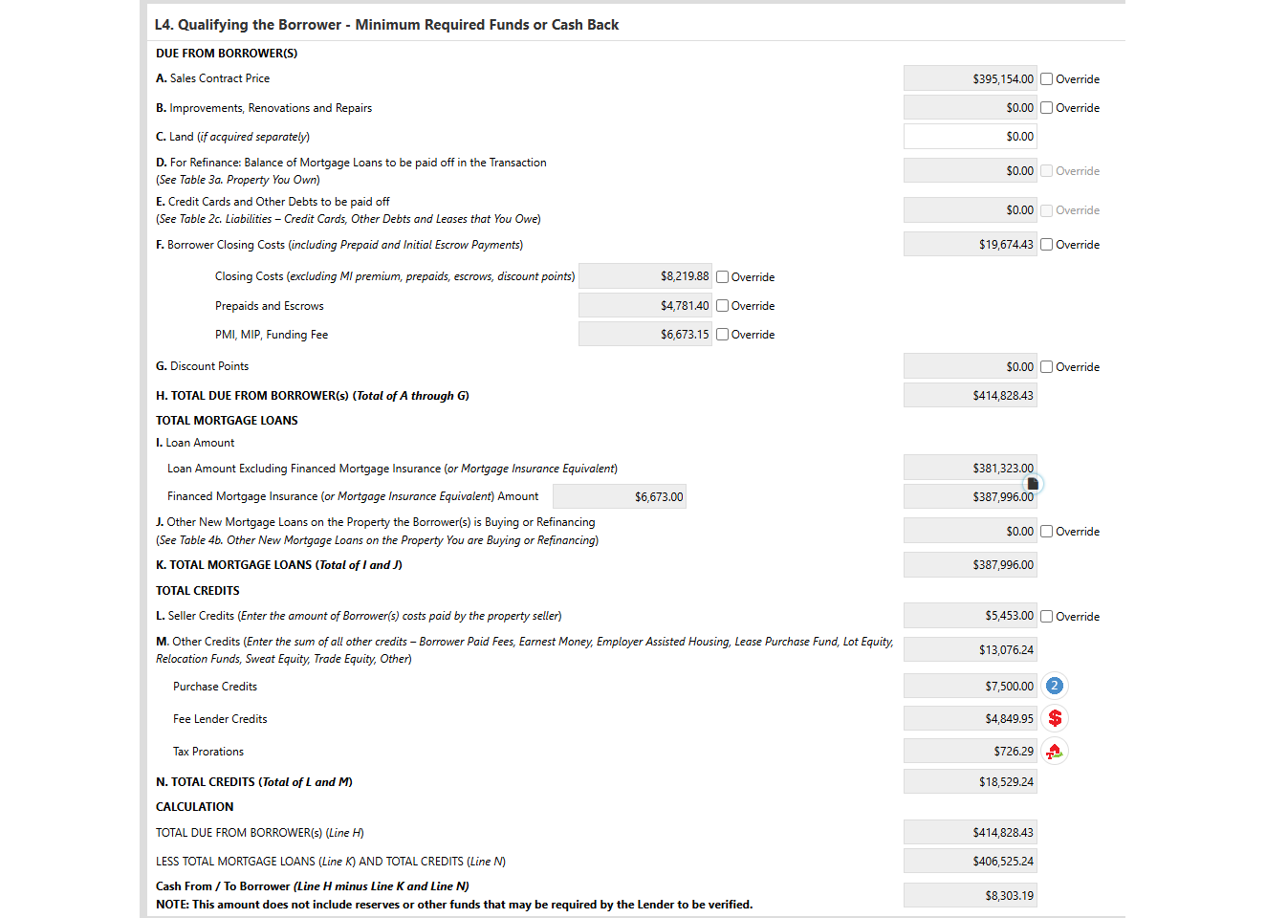
DOT Screen
Not to be overwritten except by the Closers

Slide 4
Closers
01
Compare Final CD to URLA Screen L (DOT Screen)
02
To balance the DOT to CD, an override may be necessary. Section K of the CD does not calculate in closing costs. VA when itemized, left over credit in Section L manually added To credit.
03
Only Send back to UW to update conditions if the Cash To close is Over the Condition Provided

Slide 5
Processing/UW
01
Please do not Make changes to this Screen for Cash to Close or Taxes
02
Changes can be made once the CD is balanced with title. Prior to this, Closers do not have accurate figures. If it’s needed for a clear to close. Closer may pad it higher for safety.
03
Assets should be above MRI when possible. As we reach the tax season, changes are often made last minute that can increase buyers' cash to close. Best practice would be to verify more assets then required.

Slide 6


What Happens after a loan is Closed
Example of Errors due to DOT Screen and Assets
Credit is over IPC-FHA will require a principal reduction
Conventional will refund the buyer and buyer must send the builder the money
Not enough Assets verified-Requires us to go back to the buyer to obtain assets post-closing Example would be gift received at closing was not what was required to close with to cover reserves or MRI per AUS Findings

Slide 7

An accurate DOT screen protects the borrower’s cash to close — and keeps surprises off the table before and after closing.

Slide 8
Q&A
.
Together, we can achieve extraordinary success.

