Slide 1



Momentum in Motion
Velocio Mortgage Summit 2026
Presented by: Velocio Mortgage
Date: October 2026

Slide 2

Processor Control Panel
The In’s and Out’s of the PCP

Slide 3

The Salesforce PCP was developed as a tool to assist in effective pipeline management. Consider it a “one-stop shop” for all of your statuses, notes, and daily tasks due.

Slide 4
How can I locate the correct dashboard?
https://houseloan.lightning.force.com/lightning/r/Dashboard/01ZJx000005jS0TMAU/view

Slide 5
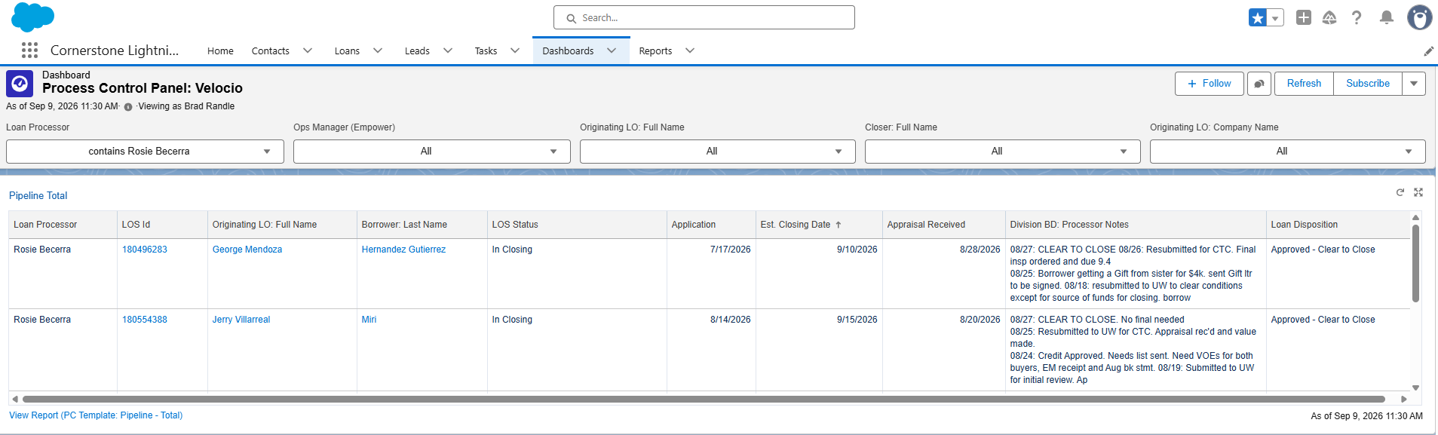
Individual Dashboard

Slide 6
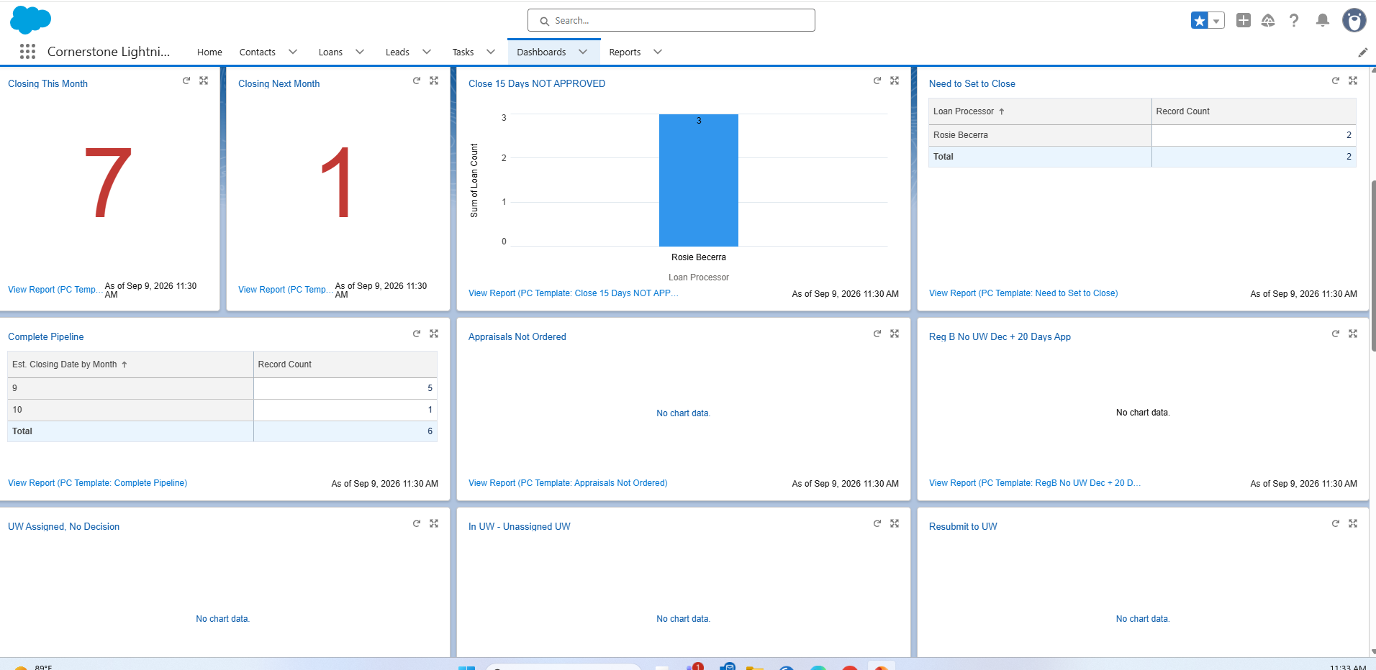
Quick Glance

Slide 7

Simply Click “View Report”. This will bring up the report requested. Use the “Edit” function to “Export” and use “Details Only”. This will bring up all data applicable to the report requested in an editable format.
Pull Reports with Ease
The PCP was designed to be able to pull reports in any category with a simple click of a button. You can pull your entire pipeline, pull only loans needing STC, pull loans in the closing pipeline, basically any report you need to complete your daily functions.

Slide 8
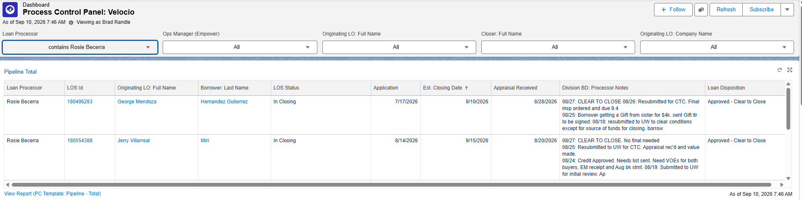
Start with Today
Pull your pipeline report or view in the PCP
To pull a report in an editable format, simply click “View Report”, then “Export”, “Details Only”
Review Loans Closing Today – Do you have everything needed? Are LQI’s complete?
Review Loans Funding Today – Are all builder docs in? Are LQI’s cleared?
Review Loans at Risk – Do we need to move or do we have what we need?

Slide 9
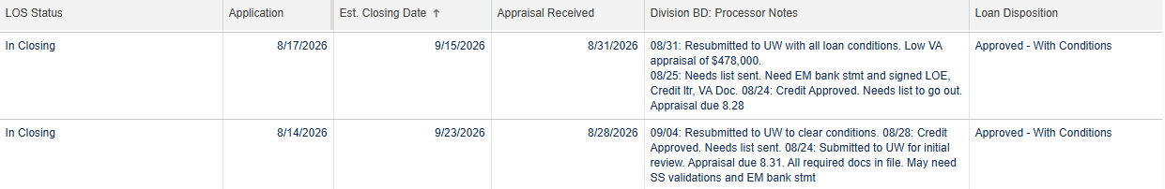
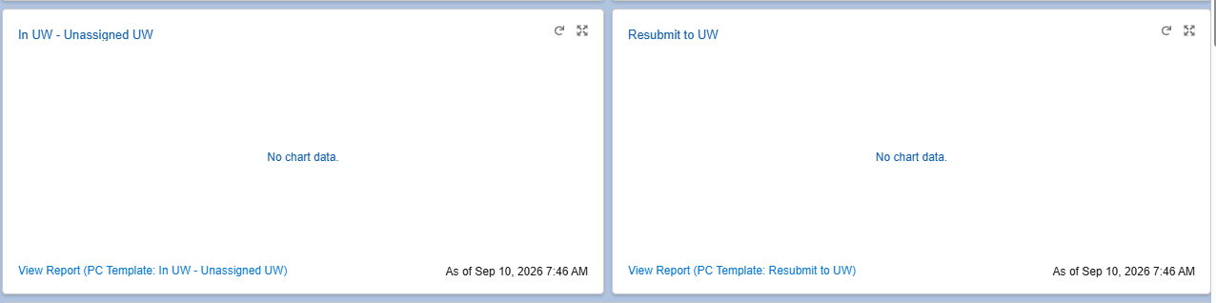
Move on to URGENT – Loans closing in the next two days
Review your notes – Are there missing documents needed?
Review loan status – Is it Cleared to Close or does it need to go to Underwriting?
Review your LQI’s – do we have everything we need to clear?

Slide 10
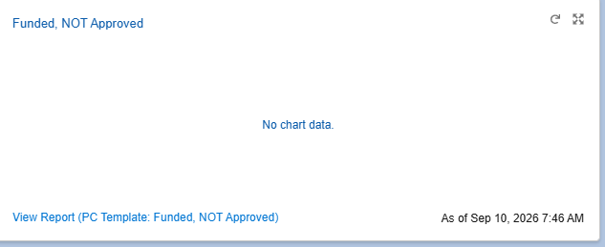
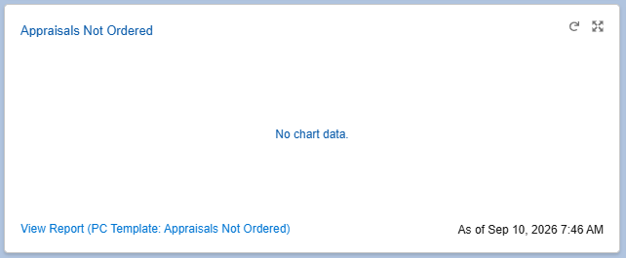
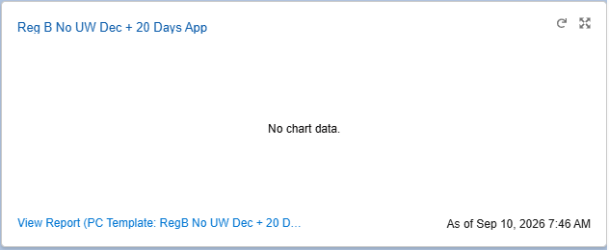
Next – Review your Pipeline
What Needs Action? Do I have loans Funded Not Approved that Need Attention? Do I have Reg B loans Needing NOI’s? Do I need Appraisals Ordered? What Can I Move Forward?

Slide 11
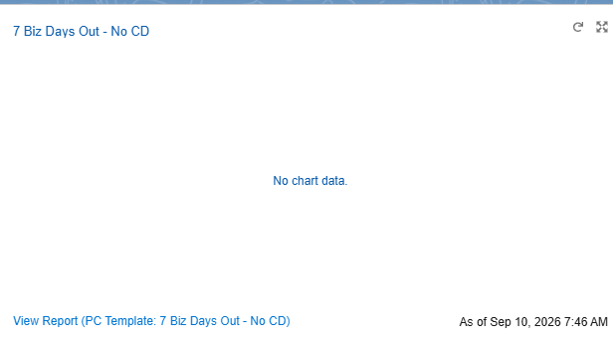
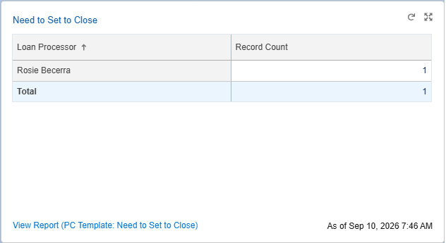
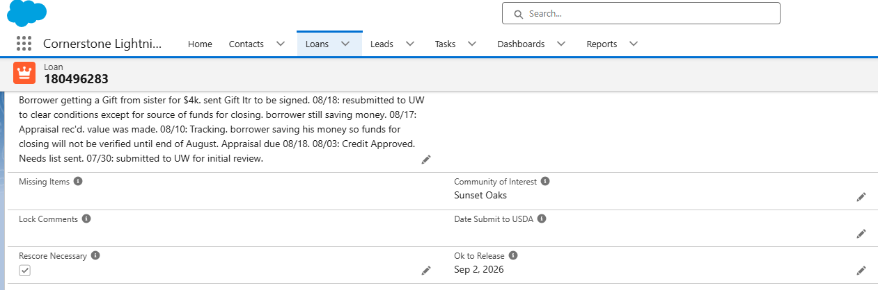
Next – Look Ahead
Do I have Upcoming CD’s pending? Do I need loans Set to Close? Do I need loans submitted to USDA? Are my docs released?

Slide 12
End-of-Day Check
Did I move my pipeline forward? Are there preventable fires for tomorrow? Are my loan statuses reflecting accurately?
The overall goal of the PCP is to let Salesforce tell you where to spend your time. Don’t let your inbox rule your day – let the PCP run your day!

Slide 13
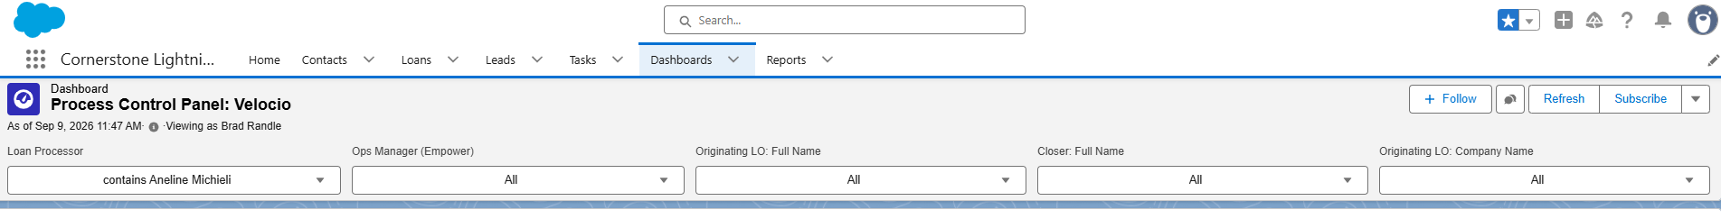
Did you Know?
The PCP was designed for transparency. You can access your peer’s pipelines as easily as you can your own. Simply use the drop box under the category and choose the name needed. You can check status, update notes, and pull reports just as easily as you can pull your own. This is a helpful tool when covering for others.
Foundation Inspection
Framing Inspection
Building Final Inspection

Slide 14
Using the PCP every morning will allow you to effectively and efficiently manage your pipeline.
See it. Prioritize it. Work it. Move it!
Questions?

