Slide 1
Xactus
Credit report and voe invoices

Slide 2

Invoice accuracy matters
Trigger your bundle
Pull and provide accurate invoices
Complete, correct invoices keep billing clean and prevent downstream disputes and cures.
Confirm the fees Xactus charges us
Do the due diligence on every charge so we only pay what we actually owe.
Act fast on billing errors
Know the steps to flag, escalate, and resolve an error as soon as we spot it.

Slide 3
Pulling your credit report invoice

Slide 4
Step one: pull your loan up in Xactus.
Search by loan number.

Slide 5
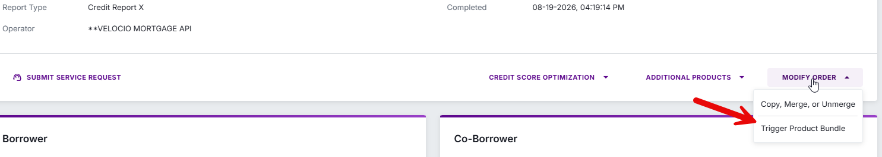
Trigger your bundle

Slide 6
Why timing matters
Triggering the bundle early costs us $318.00 instead of $70.00 — a $248.00 hit on every file pulled too soon.
Only trigger once you are positive the loan will close.
That is why files cannot be submitted to closing sooner than 15 days prior to close.

Slide 7
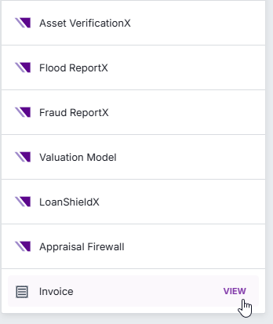
Once you’ve triggered your bundle,
Scroll to the bottom of the page.
On the left side of the screen, click View next to Invoice.

Slide 8
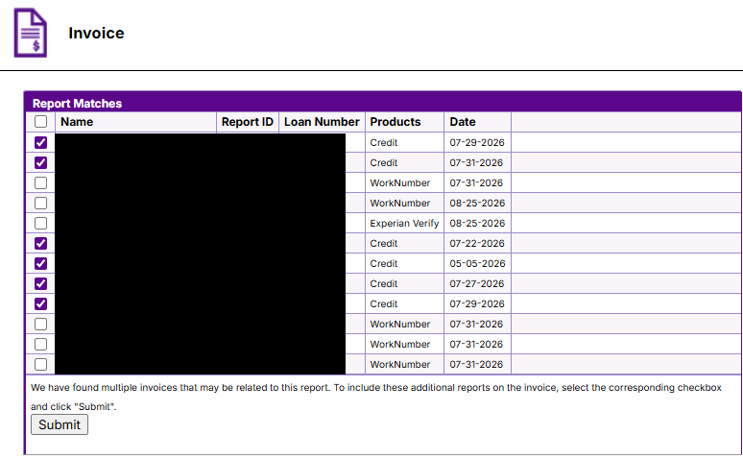
Quote
Select every line item that pertains to credit.

Slide 9
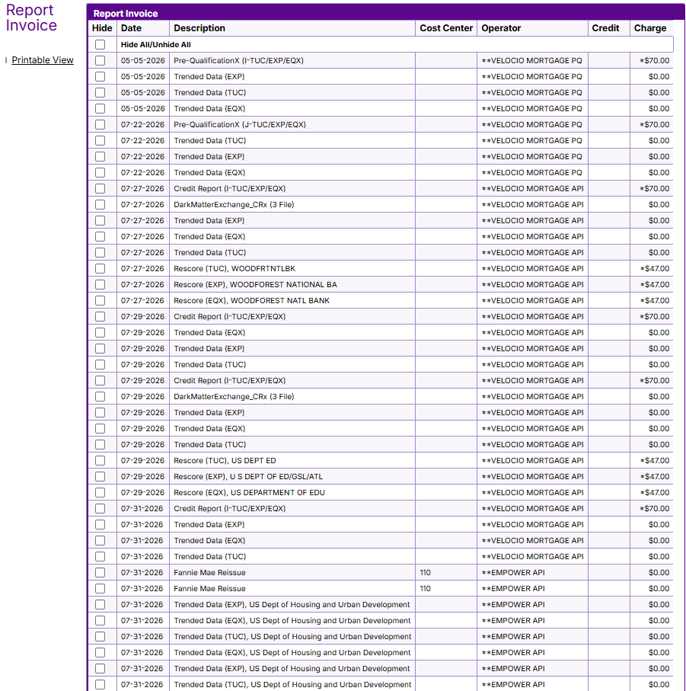
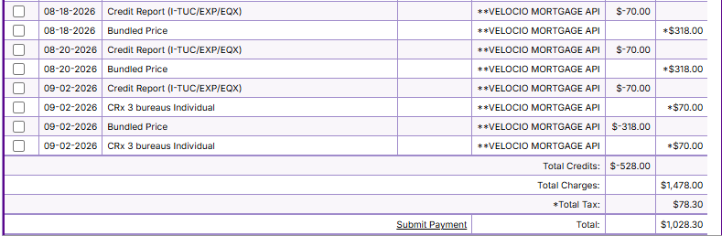
Hide all fees that are not passed along to the borrower by clicking the box next to the line item.
Pre-Qualification
Rescore (however we do charge for the new credit report associated with the rescore.)
Fraud ReportX
Flood ReportX
Asset VerificationX
Social Security VerificationX

Slide 10
At this point, make it make sense.
Once you’ve triggered your bundle, make sure you have your $70 credit for your $70 credit report pull.
If your invoice is more than $318.00 + tax, double check why.
It should only be because another credit report was pulled.
Also, make sure you don’t have multiple bundles on your invoice.

Slide 11
Check your invoice
Confirm the $70 credit for your $70 credit report pull.
If the invoice tops $318.00 + tax, find out why.
The only valid reason is an additional credit report pull.
Make sure only one bundle appears on the invoice.

Slide 12
But wait, you’re not done yet!!!
Click Printable View.
Then click Print.

Slide 13
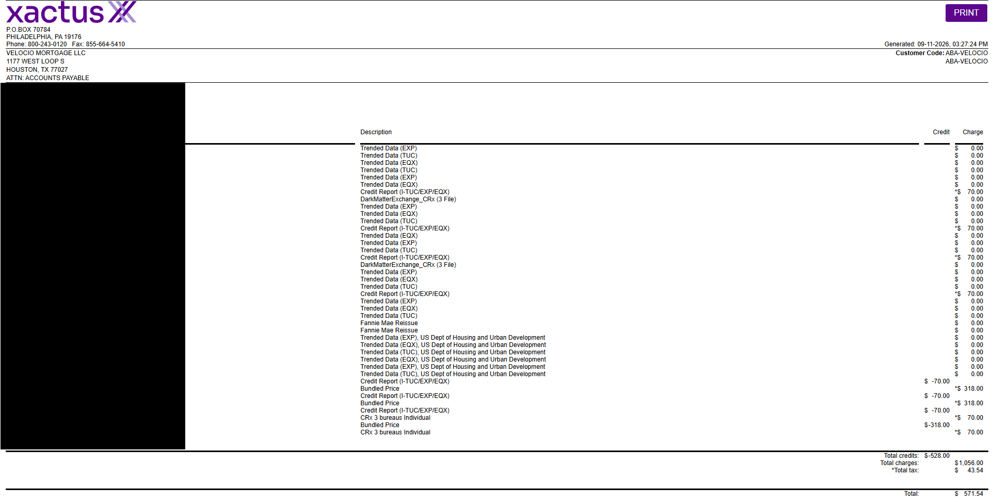

Slide 14
You need to reach out to Xactus and tell them to remove the duplicate. We are only to be charged one bundle price per loan.
That email is cornerstonesupport@xactus.com
If you have multiple bundles charged

Slide 15
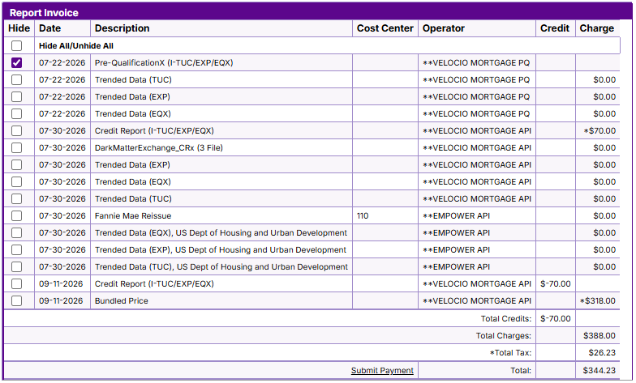
Normal invoice

Slide 16
Pulling your
VOE invoice

Slide 17
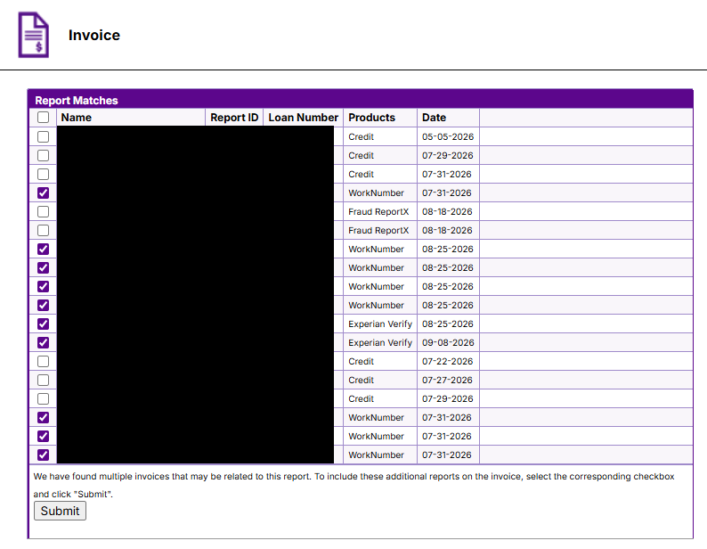
Select all VOE items.
Click Submit.

Slide 18
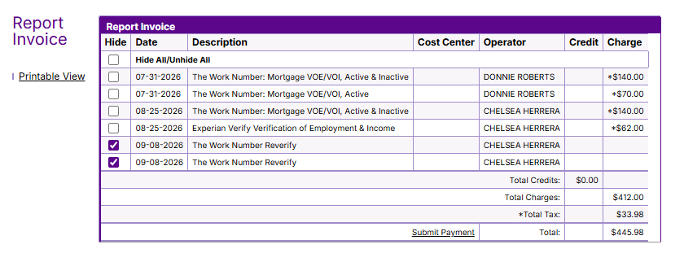
At this time we are not charging for LQI VOEs, so if you’re pulling an invoice and these charges are on there also, Hide them.
Click Printable View and Print.

Slide 19

Q & A
Panel discussion session

